Slide 1
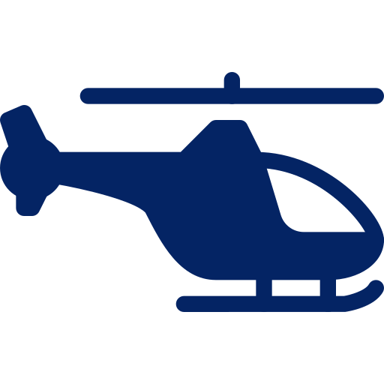
AIRBUS ENGINEERING CASE
AIR WEDGE
“GOODBYE” TEAM

Slide 2
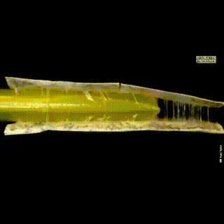
Air Wedge reduces the contact surface area between metal and rubber:
Inserting an extremely thin deflated tube under the rubber sleeve
Inflating the tube with hot air
Filling the formed gap with lubricant
“GOODBYE” TEAM
Sources: DOI: 10.1126/scirobotics.aan3028

Slide 3




challenges
01
tubing
02
Keeping
safety
03
HARD rubber
04
Steady
displacement
How to ensure smooth insertion of the tube under the rubber sleeves.
Preventing shafts from any mechanical damage.
Over 6 years of exploitation, the rubber oxygenates and becomes hard.
Ensuring smooth and controlled movement of the flange by using lubrication and applying controlled pressure.
“GOODBYE” TEAM

Slide 4

How we overcame those challenges
01
tubing
02
safety
03
Hard rubber
04
displacement
Application of a needle and thread method with increasing tube diameter.
Reduce rubber tension and its adhesion to the shaft to minimize damage risk when removing the rubber.
Managing the thermal expansion and hardness of rubber under varying temperatures.
Apply a constant linear force to push out the rubber smoothly.
“GOODBYE” TEAM

Slide 5
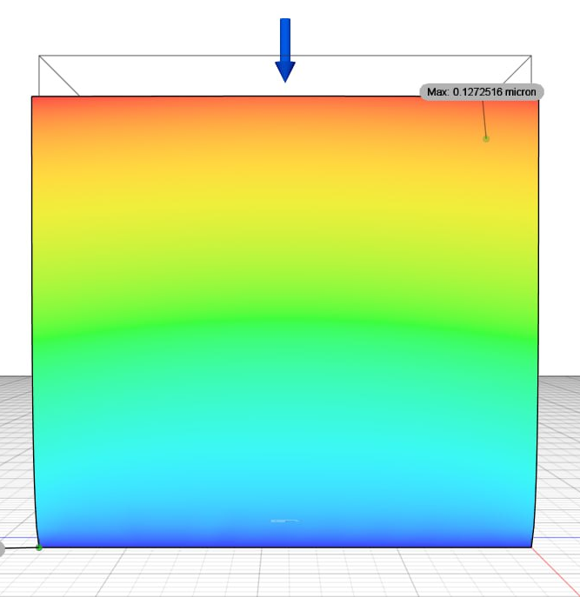
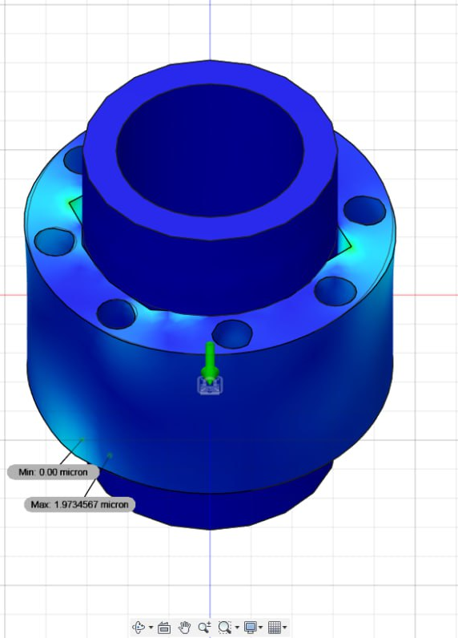
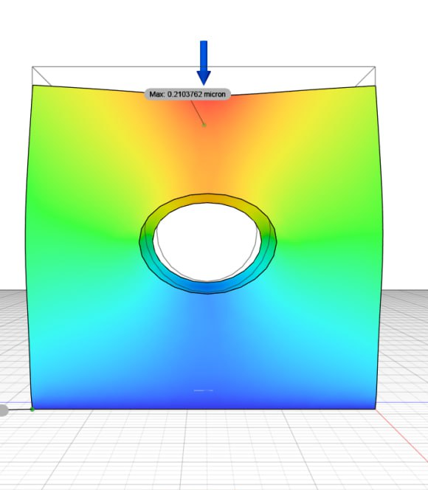
Rubber destruction
Rubber failure, both structural and methodological, greatly diminishes its physical properties. Adding eight small holes along the sleeves contour eases tension and weakens adhesion to the shaft.
Procedure
A well-defined methodology for dismantling rubber bushings streamlines the process for workers. Repetitive tasks improve efficiency and speed up completion
“GOODBYE” TEAM

Slide 6
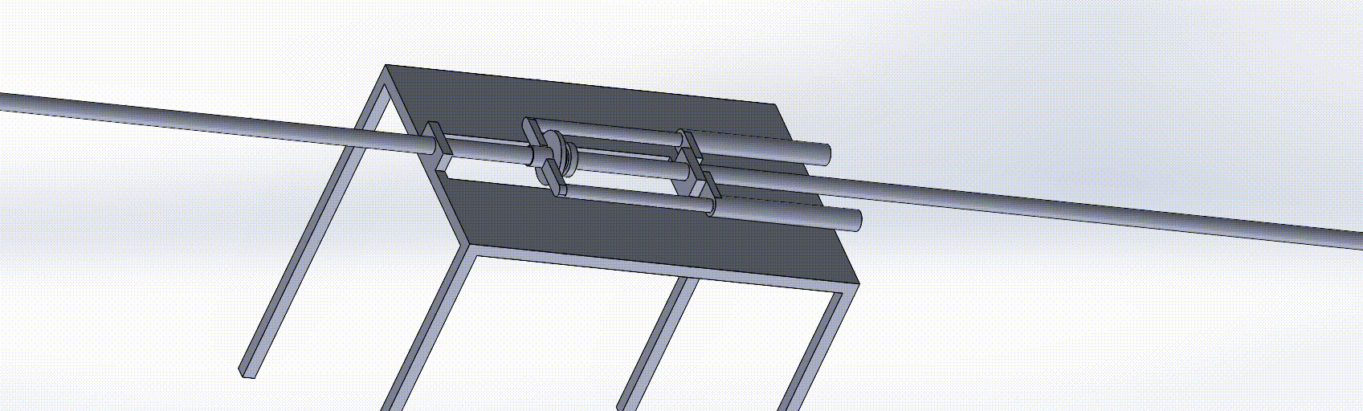
Apparent idea
Steady displacement
01
Clamp
Rigid clamping element that locks onto the shaft, eliminating any free parts.
A compact tool that clamps securely to the shaft and includes an integrated, sliding bearing press that moves along a guided track.
02
Actuation
Lever system mounted on a slide that pulls the bearing off the shaft.
03
Adaptability
Navigate the rivet area by applying a uniform force distribution
“GOODBYE” TEAM

Slide 7
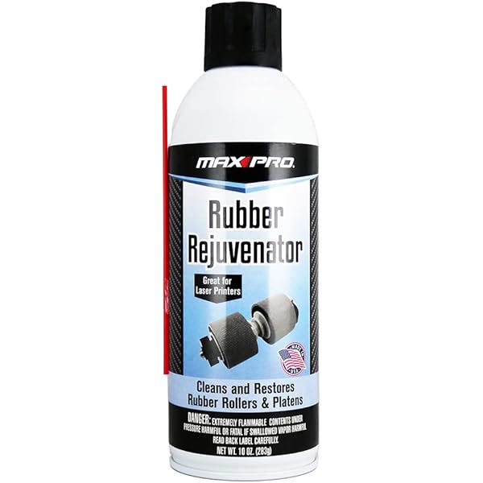
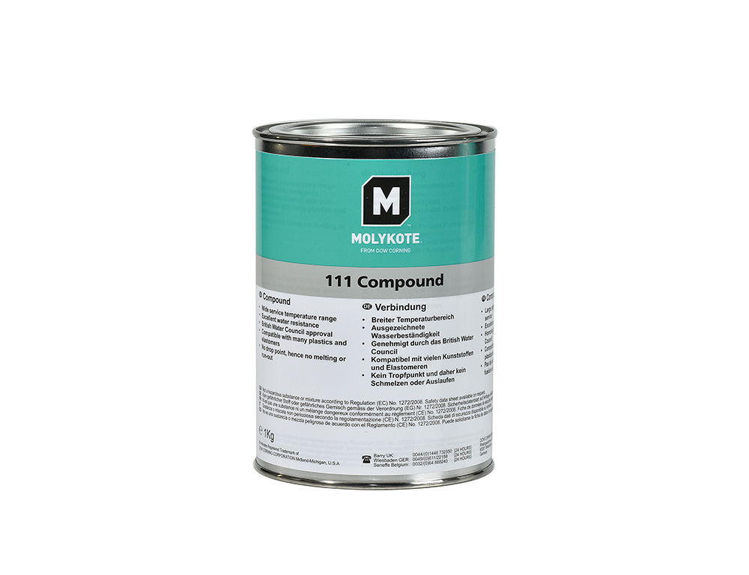
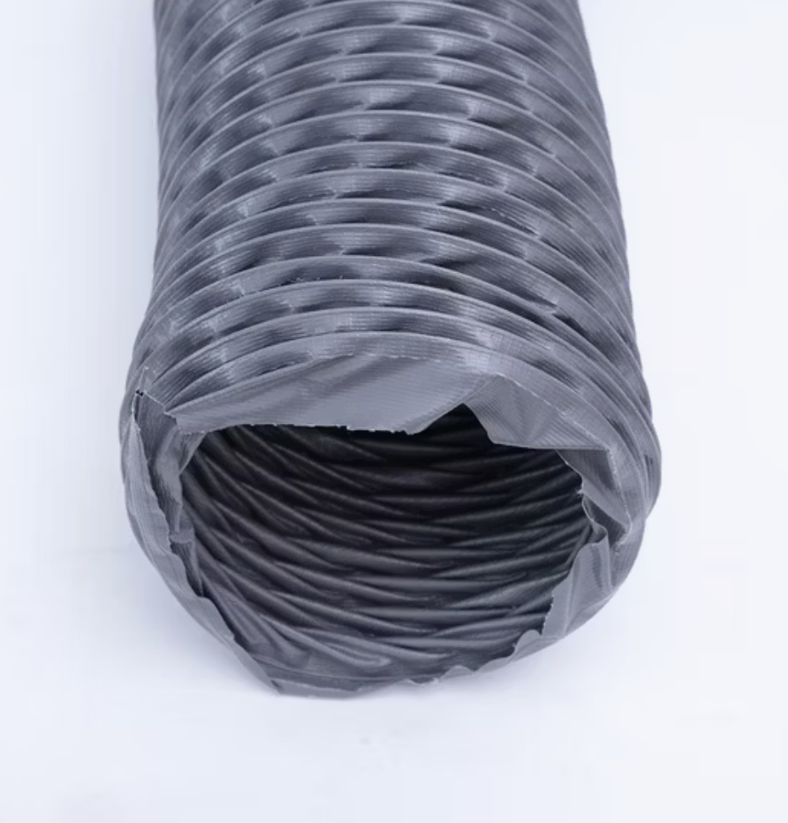
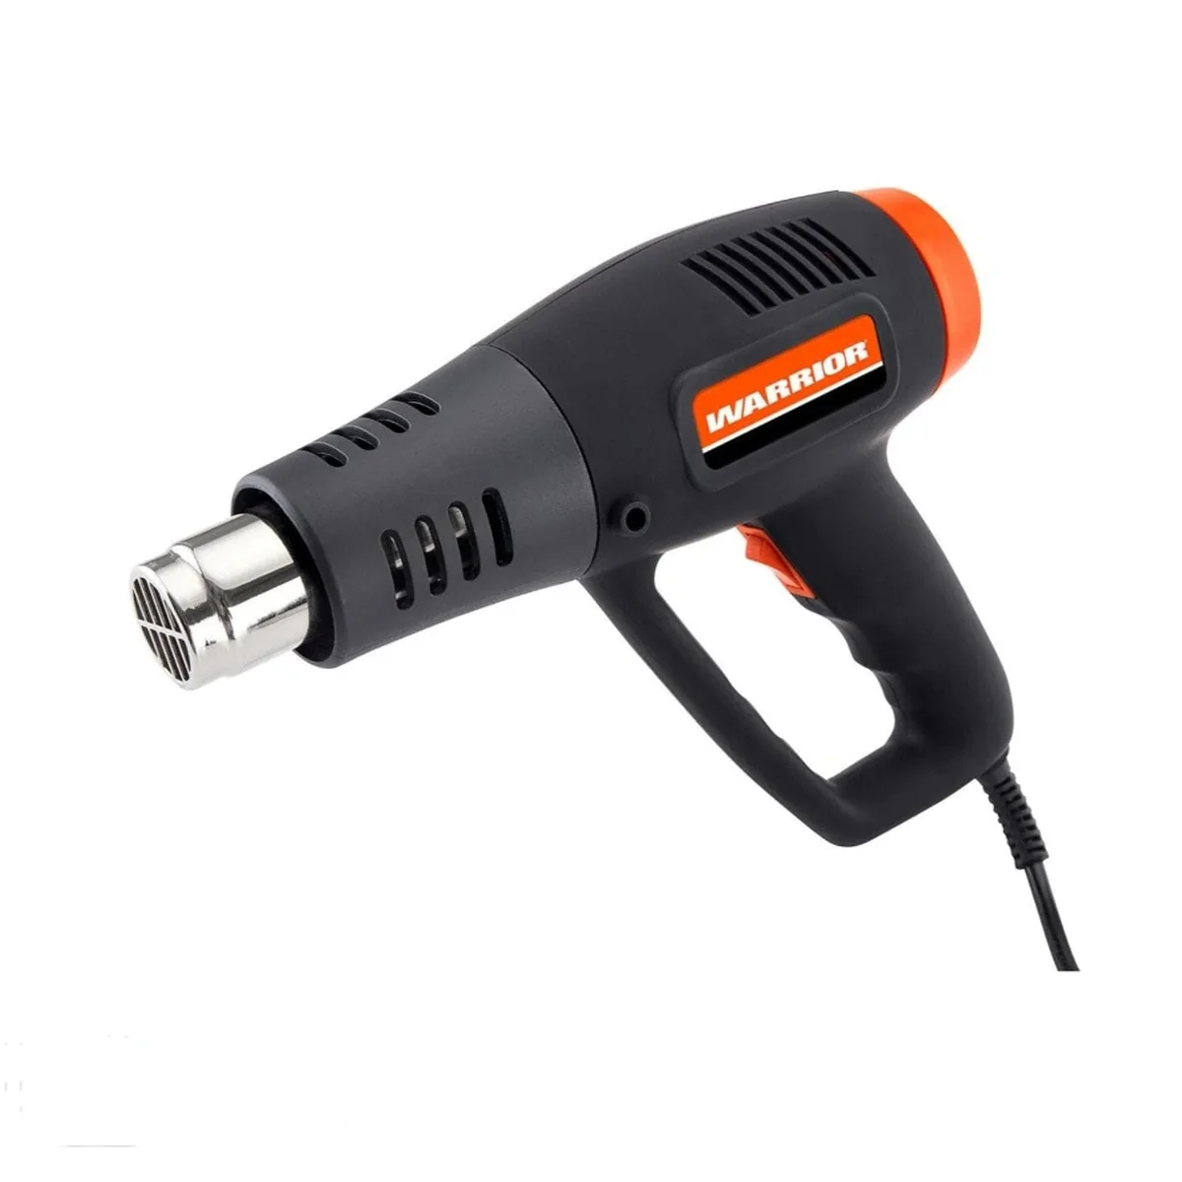

Main Idea
Tubing components
Cheap and Effective engineering
Similar to a tight ring on a finger, nylon thread and grease lower friction, making removal effortless. This technique enhances efficiency while lowering the risk of material strain.
“GOODBYE” TEAM

Slide 8
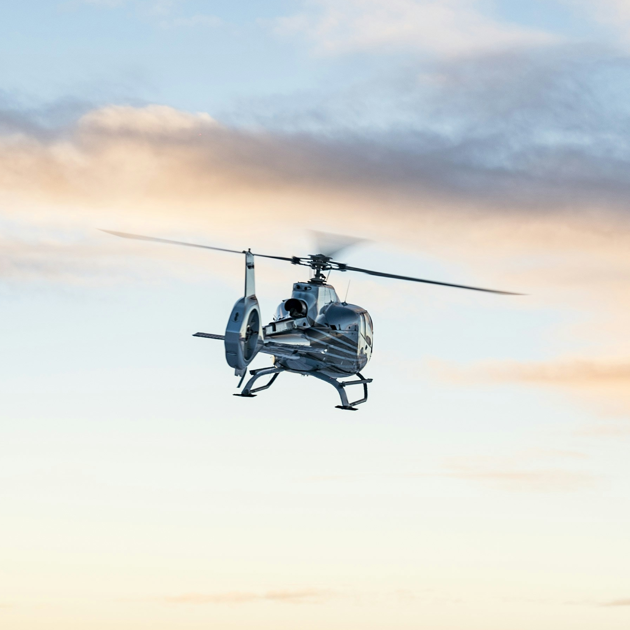

Advantage of our solution
Affordable
Nylon tubing is cost-effective, easily sourced, and quickly replaceable.
Implementation
This solution is adaptable and works alongside other methods. Seek combinations to further improve efficiency.
SAFETY
By using air to lift the rubber instead of mechanical pliers, the risk of damaging the shaft is significantly reduced.
“GOODBYE” TEAM

Slide 9
Thank You.
“GOODBYE” TEAM
Email & Website

